Slide 1

RUclassboard
Web Design - Group 1
Nicholas Cristiano
Abanoub David Awad
Philip AhKao

Slide 2
About RUclassboard
Online forum for classes
Great for students to interact with others outside of class
Users can create an account with a password
Posts are organized by class and time
Class names are determined by a keyword (sort of like setting up a hashtag)
Time is determined by the server, not the user, to make sure there is no time differences

Slide 3








Blueprint of RUclassboard
final
css
scripts
images
index.html
about.html
create.html
create_account.php
userpanel.php
login_nlc73.php
styles.css
login.js
rutgers.jpg
bullet.png
accounts
posts

Slide 4
Blueprint of RUclassboard
final
css
scripts
images
index.html
about.html
create.html
create_account.php
userpanel.php
login_nlc73.php
styles.css
login.js
rutgers.jpg
bullet.png
accounts
posts

Slide 5
MySQL Tables
Two tables
accounts
Stores username and password
Primary key: id (number)
posts
Stores id of user, time, message, and classid (keyword)
Primary key: postnum (number)

Slide 6
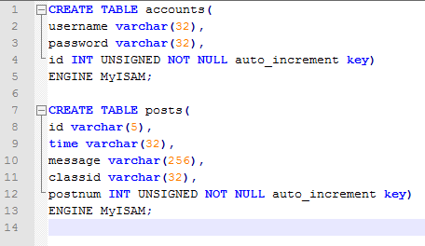
MySQL Tables

Slide 7
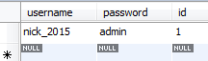
MySQL Tables - accounts
For example, created an account with:
Username: nick_2015
Password: admin
MySQL Workbench result

Slide 8
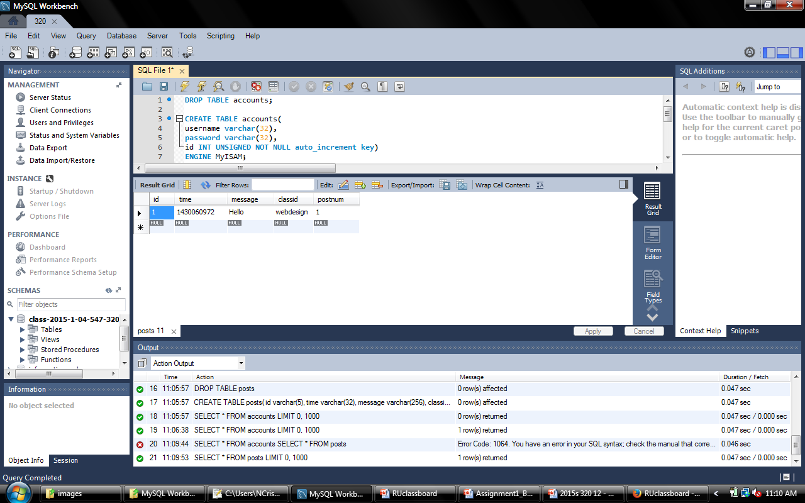
MySQL Tables - posts
Using the username, “nick_2015”, here’s an example of posting “Hello” in the class name “webdesign”
MySQL Workbench result
PHP Function microtime();
This returns the UNIX timestamp

Slide 9
MySQL Queries
A total of five queries
Creating an account
Check if username already exists
Inserting a new account
Main login page
Check if username and password matches
Main query to an inner join on accounts and posts tables. This returns the posts for the certain class in order by time
Check unique users for a class by using “Group by”

Slide 10
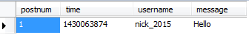
MySQL Queries – Main Inner Join

Slide 11
Main login page
How does the user stay logged in when the page reloads by sending a post or changing a class?
Used a special type of form input
<input type=“hidden” name=“variable” value=“value” />
Will not be shown to the user but shown in the source code

Slide 12
Security Checks
Creating an account (username and password)
Can only use letters, numbers, and underscores
Regular Expression
preg_replace('/[^A-Za-z0-9_]/', '', $variable);
Main login page
Class name can only be letters, numbers, and underscores
Posts go through
htmlspecialchars($variable);
mysql_real_escape_string($variable);

Slide 13
Demonstration!
Time for a demonstration!
Please go to Group 1’s final project page

